Slide 1
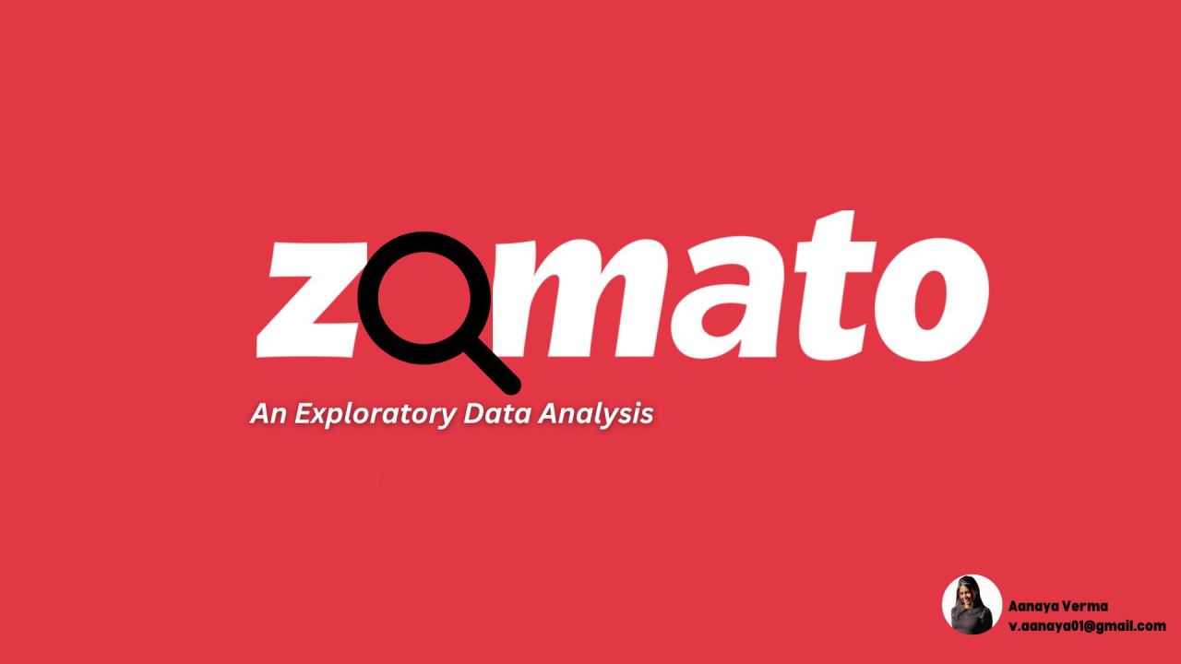
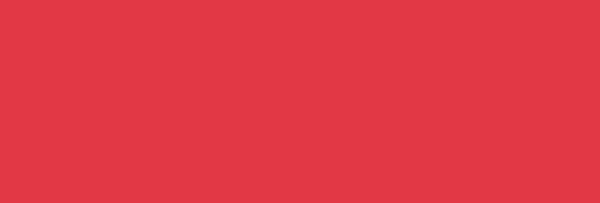

Slide 2
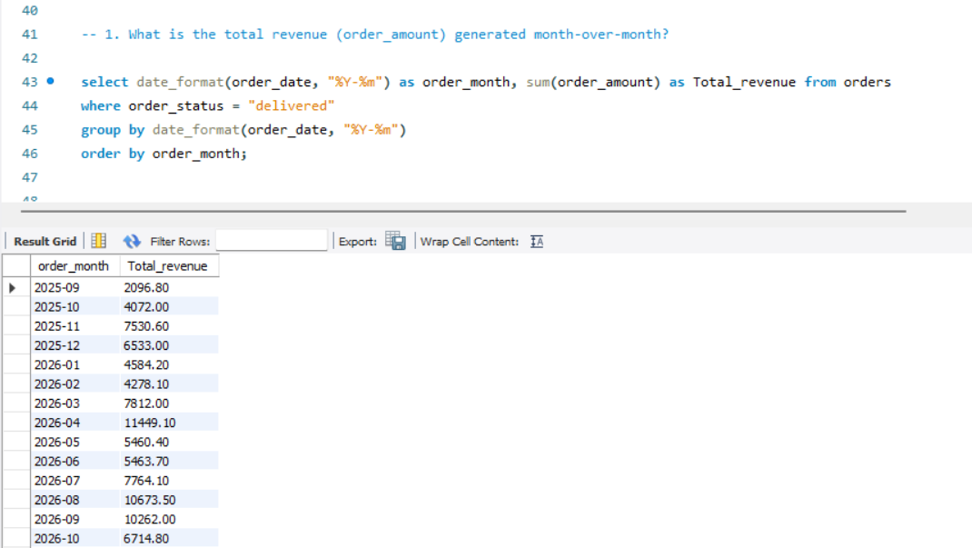
ZOMATO
Data Cleaning | EDA | SQL Insights
Restaurant & Order & Customer
Data Analysis
SQL Analysis Quary

Slide 3
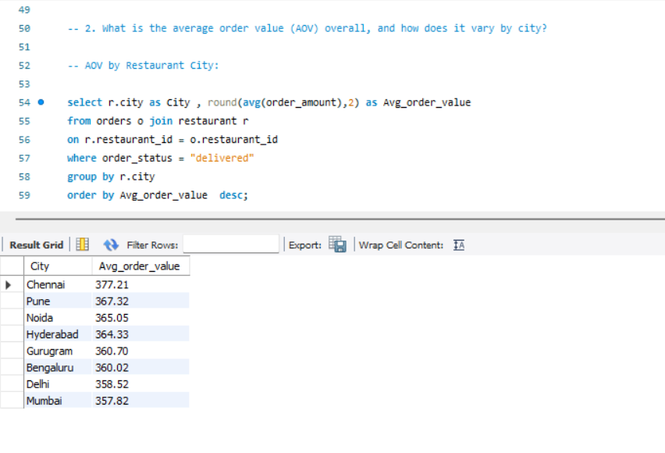
ZOMATO
Data Cleaning | EDA | SQL Insights
Restaurant & Order & Customer
Data Analysis
SQL Analysis Quary

Slide 4
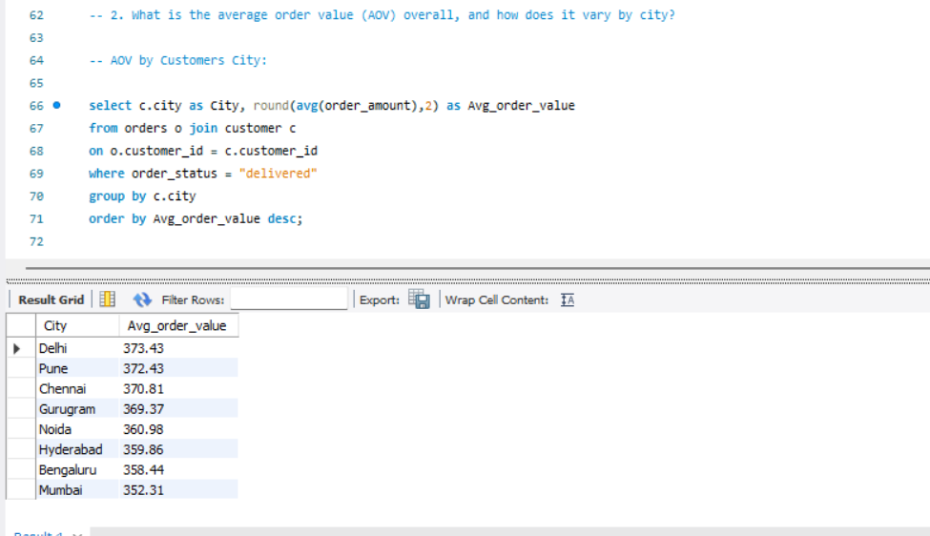
ZOMATO
Data Cleaning | EDA | SQL Insights
Restaurant & Order & Customer
Data Analysis
SQL Analysis Quary

Slide 5
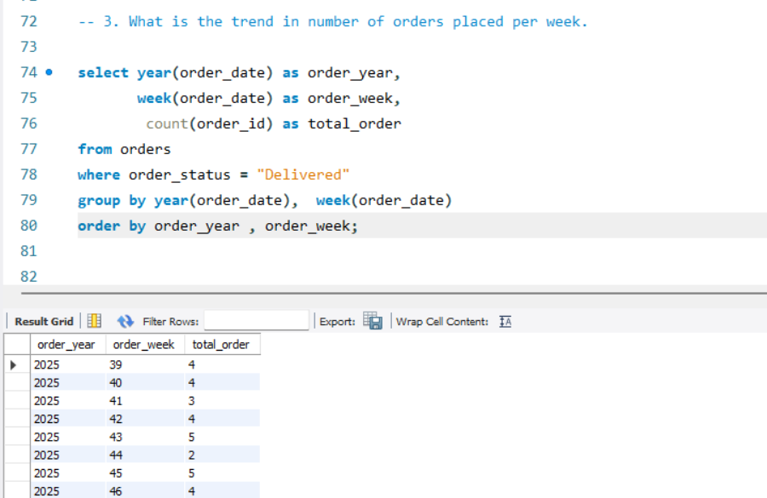
ZOMATO
Data Cleaning | EDA | SQL Insights
Restaurant & Order & Customer
Data Analysis
SQL Analysis Quary

Slide 6
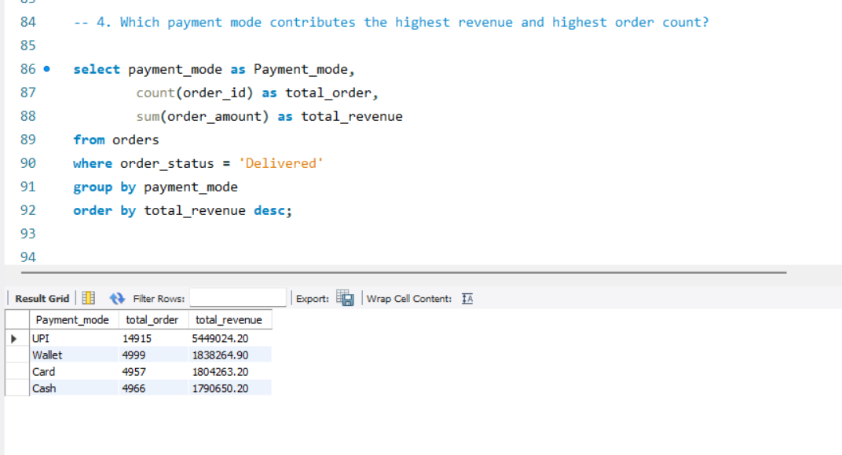
ZOMATO
Data Cleaning | EDA | SQL Insights
Restaurant & Order & Customer
Data Analysis
SQL Analysis Quary

Slide 7
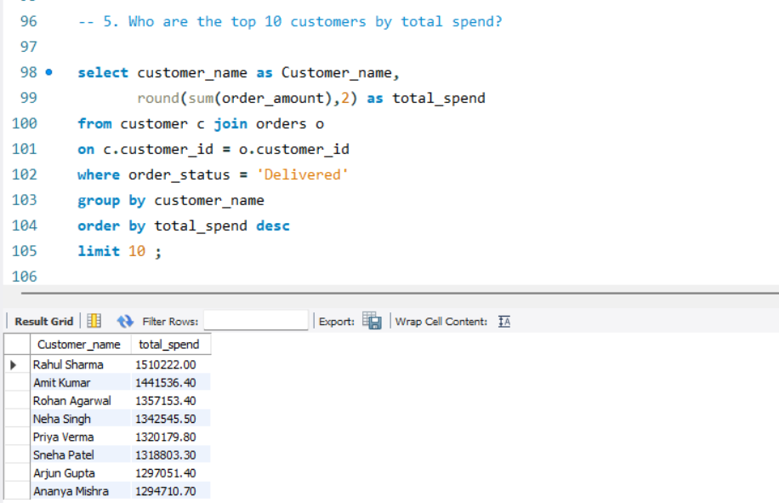
ZOMATO
Data Cleaning | EDA | SQL Insights
Restaurant & Order & Customer
Data Analysis
SQL Analysis Quary

Slide 8
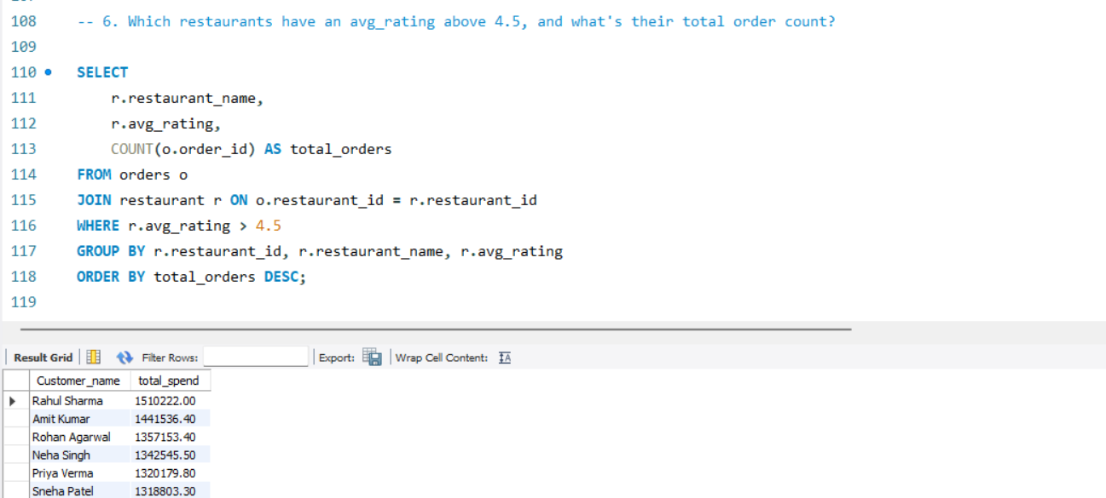
ZOMATO
Data Cleaning | EDA | SQL Insights
Restaurant & Order & Customer
Data Analysis
SQL Analysis Quary

Slide 9
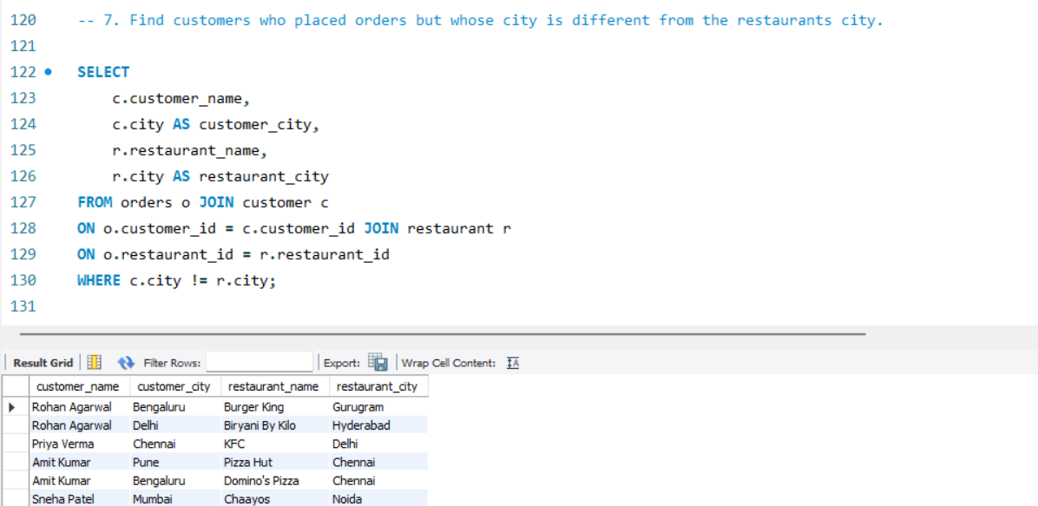
ZOMATO
Data Cleaning | EDA | SQL Insights
Restaurant & Order & Customer
Data Analysis
SQL Analysis Quary

Slide 10
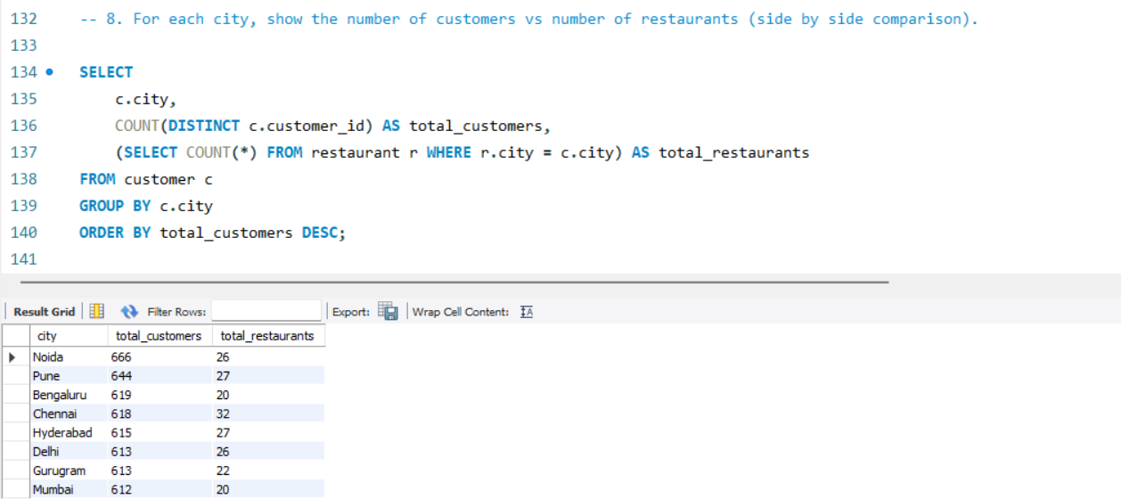
ZOMATO
Data Cleaning | EDA | SQL Insights
Restaurant & Order & Customer
Data Analysis
SQL Analysis Quary

Slide 11
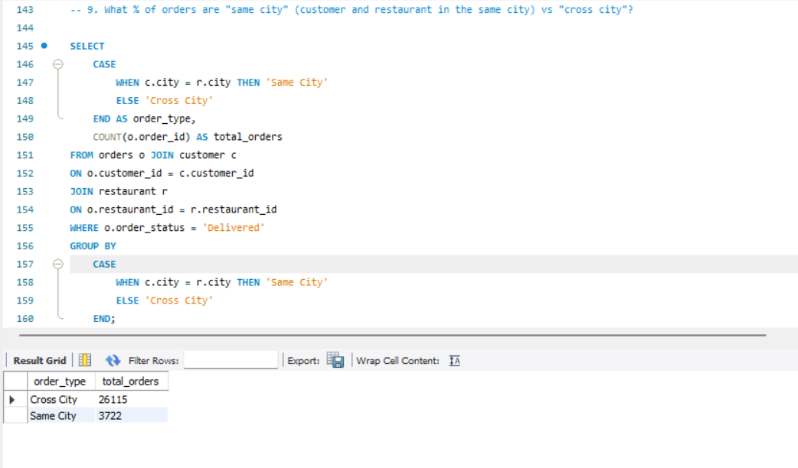
ZOMATO
Data Cleaning | EDA | SQL Insights
Restaurant & Order & Customer
Data Analysis
SQL Analysis Quary

Slide 12
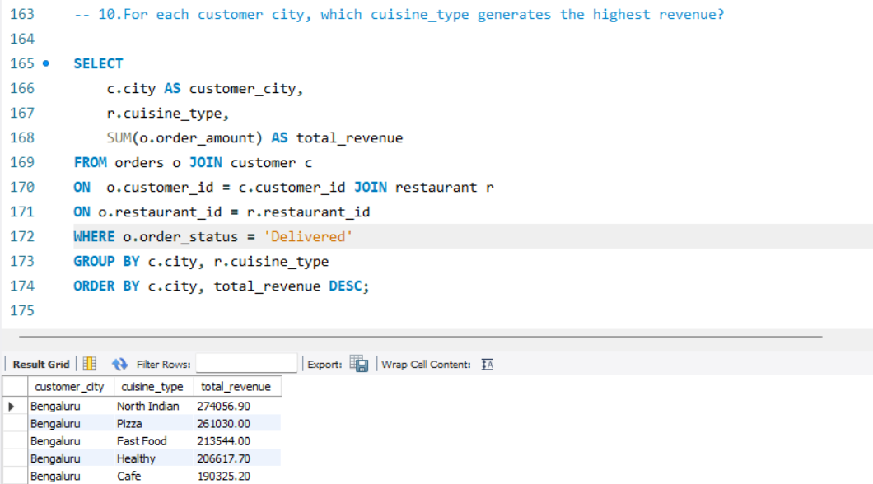
ZOMATO
Data Cleaning | EDA | SQL Insights
Restaurant & Order & Customer
Data Analysis
SQL Analysis Quary

Slide 13


